Slide 1

8th Grade Math: Pre-Algebra Unit 12, Lesson 10 Evaluating Real-World Problems Using the Order of Operations – Part 2 Volume 2, pg. 260

Slide 2


Benchmark
MA.8.NSO.1.7
Solve multi-step mathematical and real-world problems involving the order of operations with rational numbers, including exponents and radicals.
volume 2, pg. 260

Slide 3
Integrated Mathematical Thinking and Reasoning Standards
MA.K12.MTR.1.1 Actively participate in effortful learning both individually and collectively.
MA.K12.MTR.3.1 Complete tasks with mathematical fluency.
MA.K12.MTR.7.1 Apply mathematics to real-world contexts.
volume 2, pg. 260

Slide 4

Learning Target
I can solve real-world problems involving the order of operations with rational numbers, including exponents and radicals.
volume 2, pg. 260

Slide 5

Warm-Up
volume 2, pg. 261

Slide 6

12.10.1 Warm-Up: Bell Work
Find the value of each expression. Show your work.
${\left(3∙\frac{2}{3}\right)}^{−2}−4\left(6+\frac{7}{2}\right)$
$\frac{{5.5}^{2} − 9.25}{7}−\sqrt{11−2}$
volume 2, pg. 261

Slide 7

Activity
volume 2, pg. 261

Slide 8

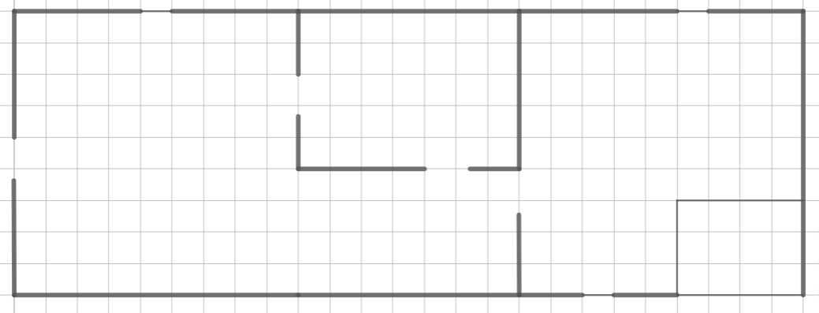
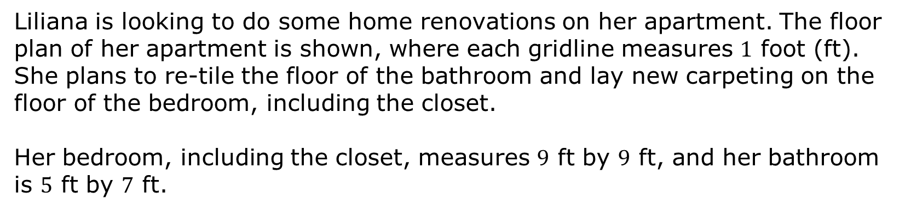
12.10.2 Activity: Station 1: Home Renovations
Liliana is looking to do some home renovations on her apartment. The floor plan of her apartment is shown, where each gridline measures $1$ foot (ft). She plans to re-tile the floor of the bathroom and lay new carpeting on the floor of the bedroom, including the closet.
Her bedroom, including the closet, measures $9$ ft by $9$ ft, and her bathroom is $5$ ft by $7$ ft.
Bathroom
Kitchen
Bedroom
Sitting Area
Hallway
Closet
volume 2, pg. 261

Slide 9
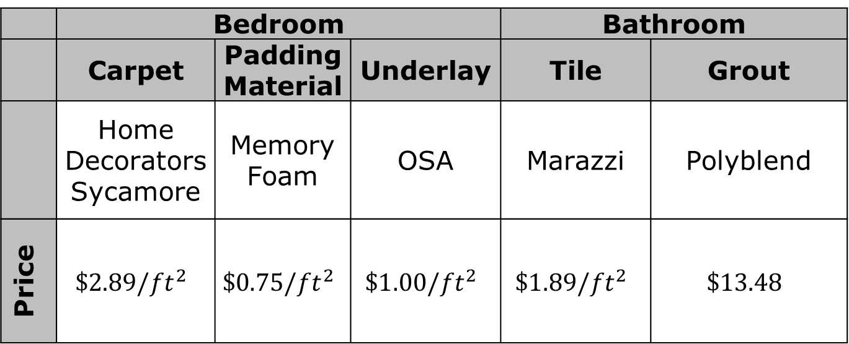
The prices Liliana found for the materials she needs to update the flooring in both rooms is given in the table.
 | Bedroom |  |  | Bathroom
 | Carpet | Padding Material | Underlay | Tile | Grout
 | Home Decorators Sycamore | Memory Foam | OSA | Marazzi | Polyblend
Price | $$\$2.89/{ft}^{2}$$ | $$\$0.75/{ft}^{2}$$ | $$\$1.00/{ft}^{2}$$ | $$\$1.89/{ft}^{2}$$ | $$\$13.48$$
volume 2, pg. 261

Slide 10
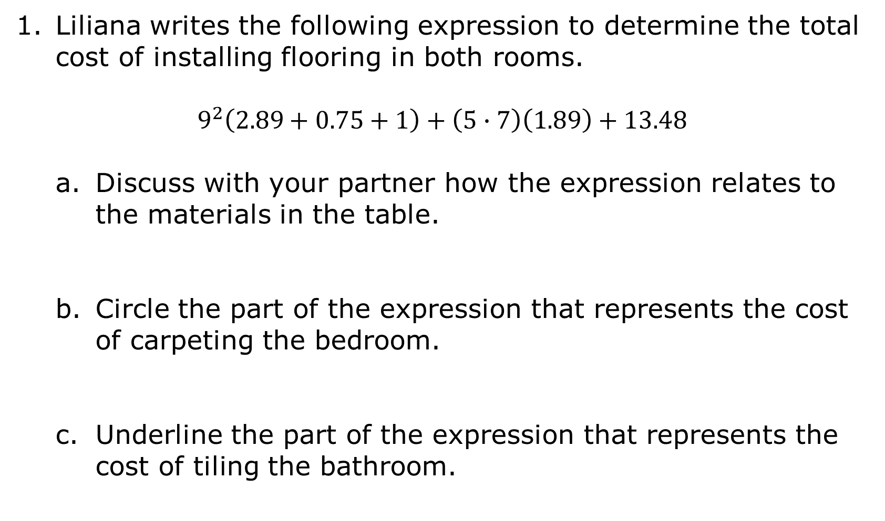
Liliana writes the following expression to determine the total cost of installing flooring in both rooms.
$$9^{2}\left(2.89+0.75+1\right)+\left(5∙7\right)\left(1.89\right)+13.48$$
Discuss with your partner how the expression relates to the materials in the table.
Circle the part of the expression that represents the cost of carpeting the bedroom.
Underline the part of the expression that represents the cost of tiling the bathroom.
volume 2, pg. 262

Slide 11
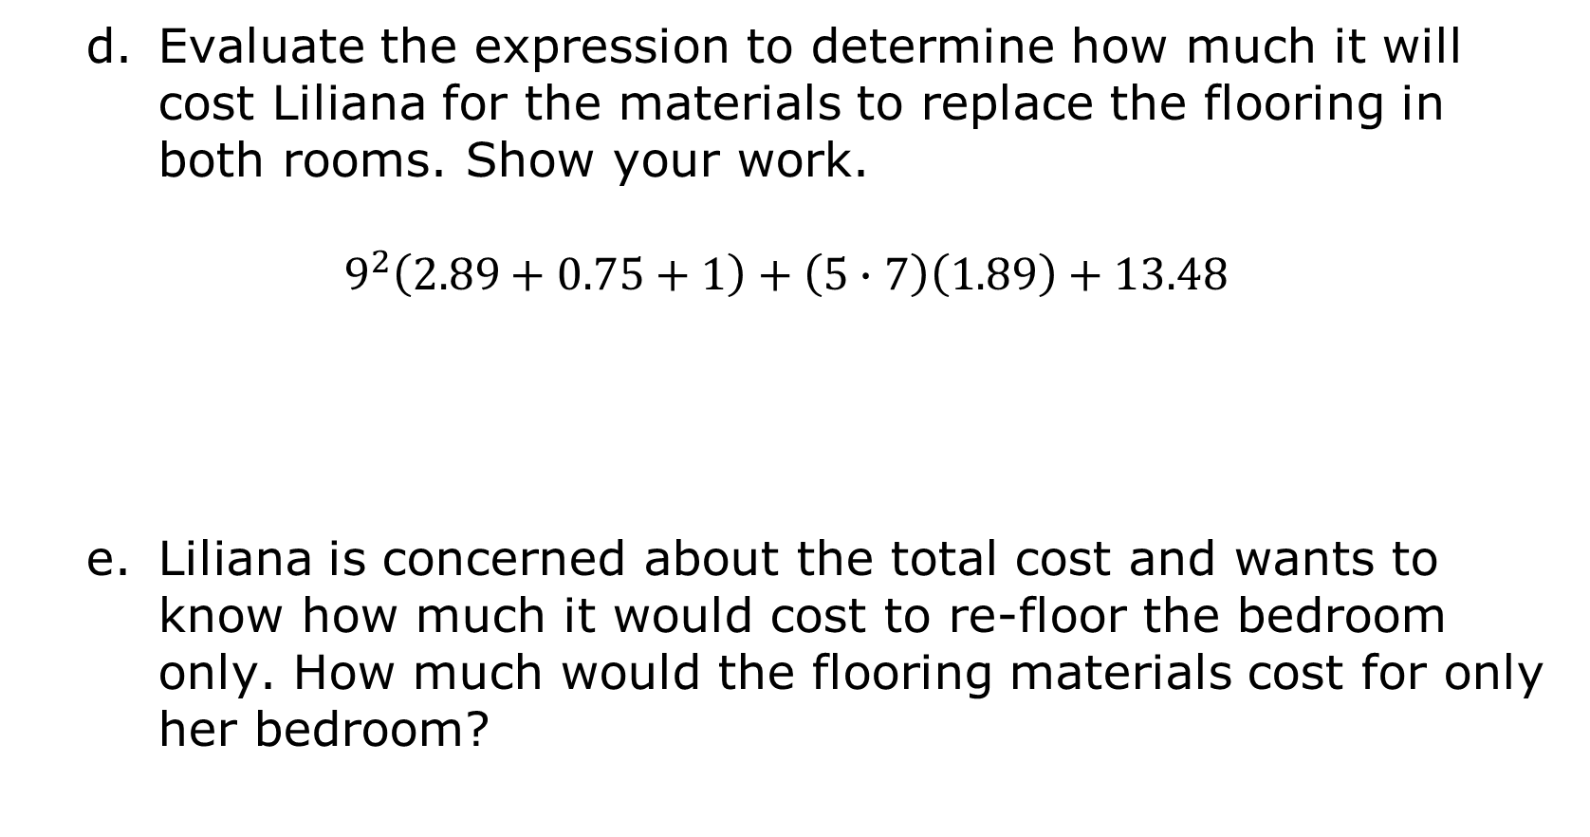
Evaluate the expression to determine how much it will cost Liliana for the materials to replace the flooring in both rooms. Show your work.
$$9^{2}\left(2.89+0.75+1\right)+\left(5∙7\right)\left(1.89\right)+13.48$$
Liliana is concerned about the total cost and wants to know how much it would cost to re-floor the bedroom only. How much would the flooring materials cost for only her bedroom?
volume 2, pg. 262

Slide 12
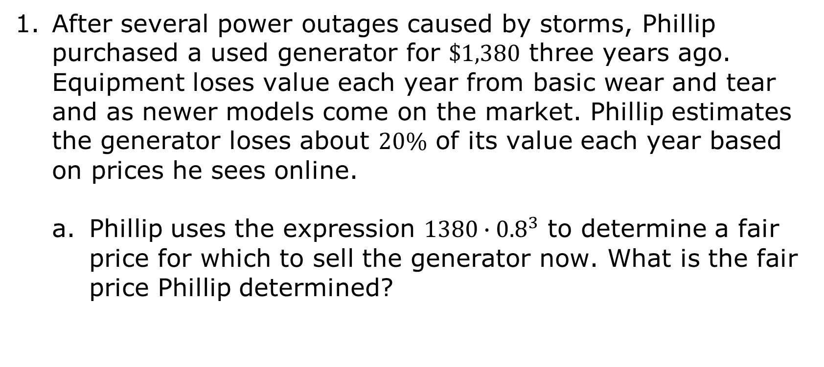
12.10.3 Activity: Station 2: Generating Power
After several power outages caused by storms, Phillip purchased a used generator for $\$1,380$ three years ago. Equipment loses value each year from basic wear and tear and as newer models come on the market. Phillip estimates the generator loses about $20\%$ of its value each year based on prices he sees online.
Phillip uses the expression $1380∙{0.8}^{3}$ to determine a fair price for which to sell the generator now. What is the fair price Phillip determined?
volume 2, pg. 262

Slide 13
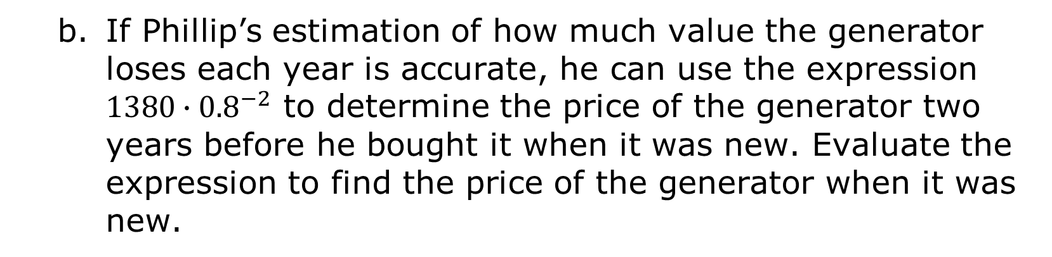
If Phillip’s estimation of how much value the generator loses each year is accurate, he can use the expression $1380∙{0.8}^{−2}$ to determine the price of the generator two years before he bought it when it was new. Evaluate the expression to find the price of the generator when it was new.
volume 2, pg. 262

Slide 14
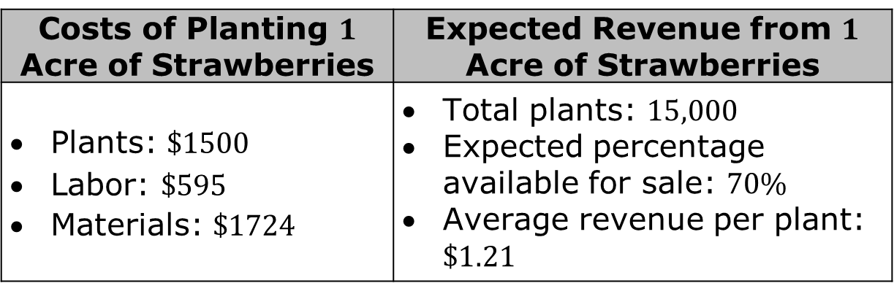
12.10.4 Activity: Station 3: Planting Strawberries
Michaela is considering planting strawberries for the first time on her farm. She has an acre set aside and wants to determine whether the costs and potential profits make sense.
After researching, she determines the following information.
Costs of Planting $1$ Acre of Strawberries | Expected Revenue from $1$ Acre of Strawberries
Plants: $\$1500$ Labor: $\$595$ Materials: $\$1724$ | Total plants: $15,000$ Expected percentage available for sale: $70\%$ Average revenue per plant: $\$1.21$
volume 2, pg. 263

Slide 15
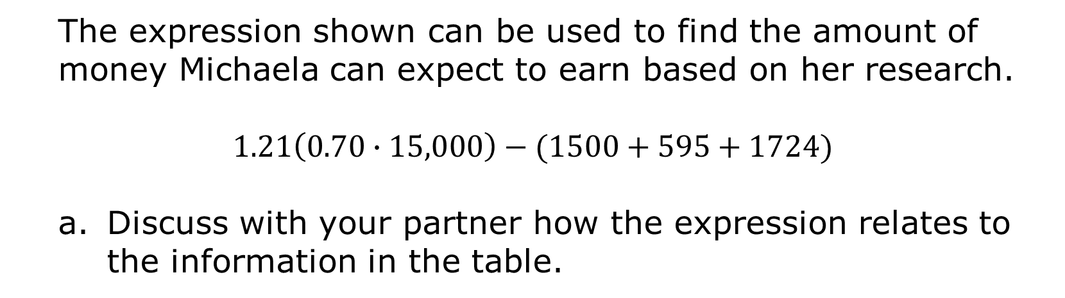
The expression shown can be used to find the amount of money Michaela can expect to earn based on her research.
$$1.21\left(0.70∙15,000\right)−(1500+595+1724)$$
Discuss with your partner how the expression relates to the information in the table.
volume 2, pg. 263

Slide 16
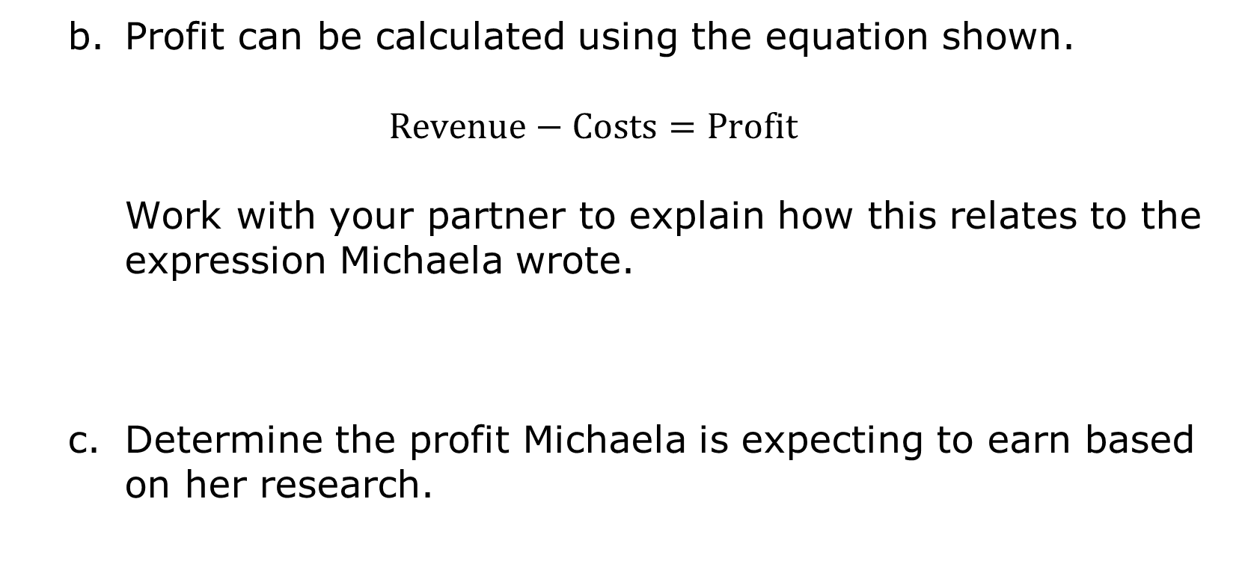
Profit can be calculated using the equation shown.
$$Revenue−Costs=Profit$$
Work with your partner to explain how this relates to the expression Michaela wrote.
Determine the profit Michaela is expecting to earn based on her research.
volume 2, pg. 263

Slide 17

Wrap-Up
volume 2, pg. 264

Slide 18



12.10.5 Wrap-Up: Reflection
Circle the icon that best describes your understanding of each learning target in the table.
I need help.
I got it.
I could help someone.
Evaluate expressions with rational numbers, exponents, and radicals using the order of operations.
Solve real-world problems by evaluating expressions using the order of operations.
volume 2, pg. 264

